Slide 1

“MUSIC PLAYLIST GENERATOR”
Sanjivani Rural Education Society’s
Sanjivani College of Engineering, Kopargaon 423 603
(Affiliated to Savitribai Phule Pune University, Pune )
Department of Computer Engineering
Prepared By,
Miss. Samruddhi Chavan [UCS23F1024]
Miss. Unnati Dabhade [UCS23F1025]
Guided By,
Prof. S. S. Gawali.

Slide 2
Contents
Sanjivani Rural Education Society’s
Sanjivani College of Engineering, Kopargaon 423 603
(Affiliated to Savitribai Phule Pune University, Pune )
Department of Computer Engineering Research Center
Introduction of project
Functionality of project
Details about Data types used in project
Details about predefine module/libraries used in project
Details about predefined function.
Output of Code.

Slide 3
Introduction
Sanjivani Rural Education Society’s
Sanjivani College of Engineering, Kopargaon 423 603
(Affiliated to Savitribai Phule Pune University, Pune )
The Music Playlist Generator is a Python-based project designed to enhance the music listening experience by creating personalized playlists tailored to the language preference and mood. Leveraging the Spotify platform, this project offers a seamless way to discover curated playlists that match the current emotional state and language preference.
Objectives
The project aims to dynamically generate Spotify playlist URLs that match the user's current emotional state and language preference. Through this project, users can explore and enjoy a diverse range of music playlists, fostering a deeper connection with their favorite songs and genres while discovering new tracks that cater to their unique tastes and preferences.

Slide 4
Functionality of Project
Sanjivani Rural Education Society’s
Sanjivani College of Engineering, Kopargaon 423 603
(Affiliated to Savitribai Phule Pune University, Pune )
Language & Mood Selection: Users choose their preferred language (Marathi, Hindi, English) and mood (Happy, Sad, Dance, Chill, Energetic, Workout).
Dynamic Playlist Generation: Based on user inputs, the project generates Spotify playlist URLs tailored to the selected language and mood.
Integration with Spotify: Users can easily open the generated playlist URLs in their web browser, allowing instant access to curated playlists on Spotify.
Error Handling: The project gracefully handles invalid inputs, ensuring a smooth user experience.
User-Friendly Interface: Clear instructions and feedback guide users through the process, making it easy to personalize their music listening experience.

Slide 5
Details about Data types used in project
Sanjivani Rural Education Society’s
Sanjivani College of Engineering, Kopargaon 423 603
(Affiliated to Savitribai Phule Pune University, Pune )
Strings: Represent text data (e.g., language names, mood options, playlist URLs).
Dictionaries: Store mappings between language and mood combinations and their corresponding Spotify playlist URLs.
Integers: Used for menu selections (language choice, mood choice) and accessing data structures.
NoneType: Represents absence of a value, particularly in case of invalid inputs or when a function does not return a valid playlist URL.

Slide 6
Details about predefine module/libraries used in project
Sanjivani Rural Education Society’s
Sanjivani College of Engineering, Kopargaon 423 603
(Affiliated to Savitribai Phule Pune University, Pune )
webbrowser: Used to open Spotify playlist URLs in the default web browser.

Slide 7
Details about predefined function
Sanjivani Rural Education Society’s
Sanjivani College of Engineering, Kopargaon 423 603
(Affiliated to Savitribai Phule Pune University, Pune )
print(): Used for displaying messages and information to the user via the console.
input(): Used for taking user input from the console.
get():A method of dictionaries used to retrieve values based on keys.

Slide 8
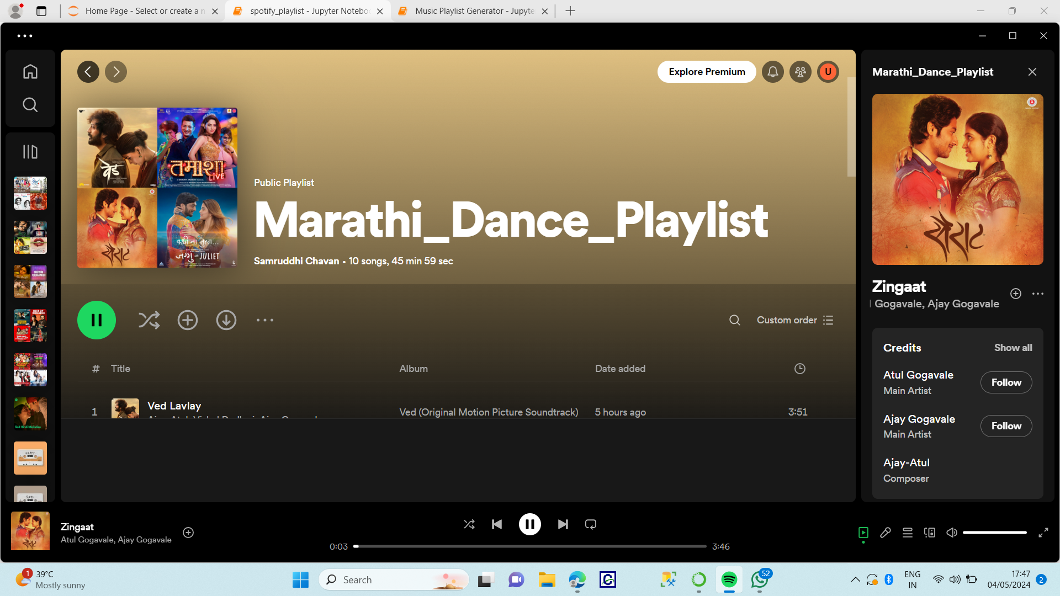
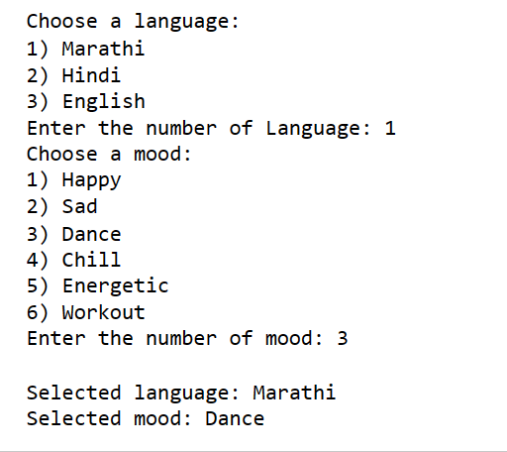
Output
Sanjivani Rural Education Society’s
Sanjivani College of Engineering, Kopargaon 423 603
(Affiliated to Savitribai Phule Pune University, Pune )

Slide 9
Thank You
Sanjivani Rural Education Society’s
Sanjivani College of Engineering, Kopargaon 423 603
(Affiliated to Savitribai Phule Pune University, Pune )

